Slide 1


VACATION REQUEST
2024-2025

Slide 2

01
Background
03
Team Members
TABLE OF
CONTENTS
Table of Contents
Objectives & Goals
02
04
05
Technology Stack
06
Core Features
07
The Visual
13
Project File Structure
16
Outcomes & Impact
Summary & Achievements
18

Slide 3



OUR TEAM
Let's meet our team members
who are professional and have
rich experiences.
Hassan joumaa
ZOULFICAR KANSO
MohAMMAD FAHES

Slide 4



Objectives & Goals
Develop a secure, multi-role authentication system.
Implement a multi-level approval workflow (Manager -> Chief -> HR).
Provide intuitive dashboards for each user role.
Automate notification processes (e.g., email upon approval).
Ensure efficient and transparent request management.

Slide 5





Technology Stack
Frontend
Component-based architecture, declarative views.
react-router-dom for navigation.
Backend
Asynchronous, event-driven, efficient server-side operations.
RESTful API development.
Communication
RESTful APIs (for seamless data exchange).

Slide 6






Core Features
Secure Login
Intuitive Request Form
Role-based access.
Easy submission for employees.
Multi-Level Approval
Real-time Status Tracking
Sequential approval by Managers, Chief Managers, HR.
Employees see their request status.

Slide 7

THE
VISUAL

Slide 8

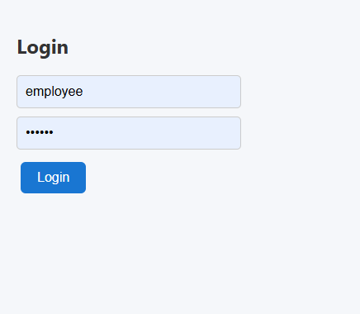
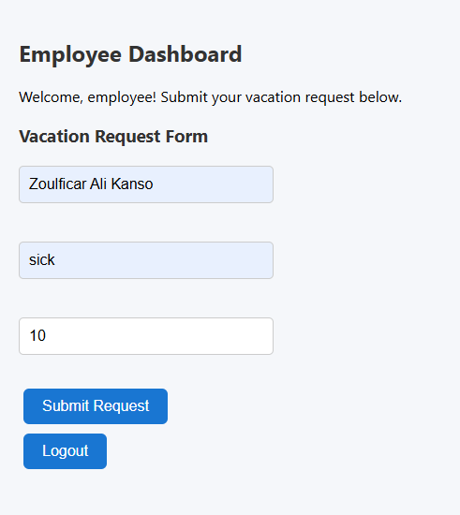
EMPLOYEE

Slide 9
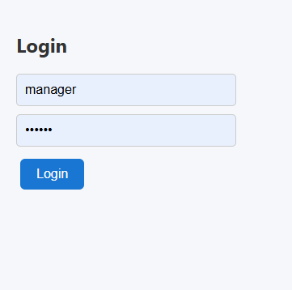
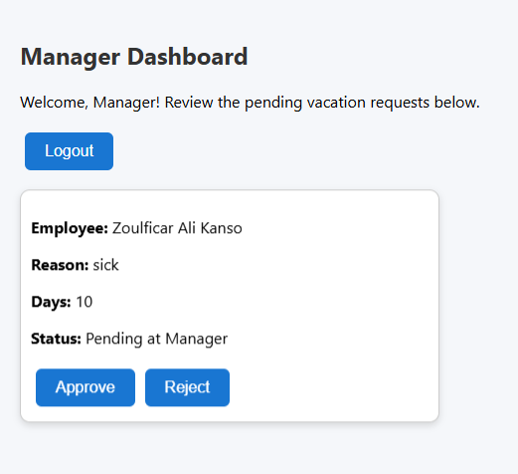
MANAGER

Slide 10
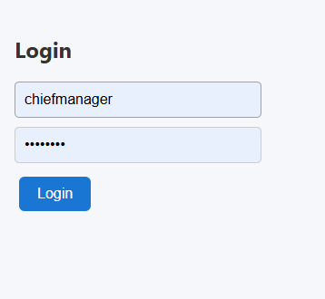
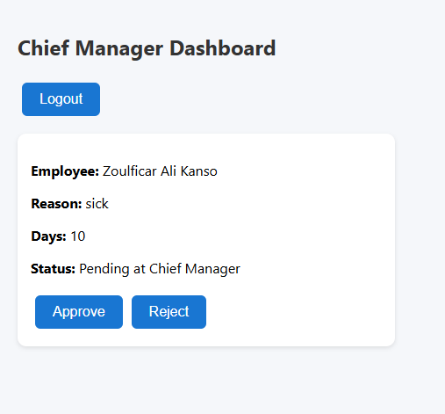
CHIEF MANAGER

Slide 11
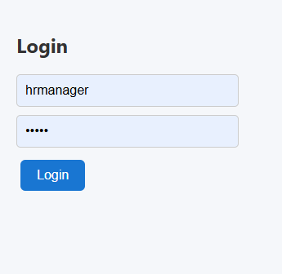
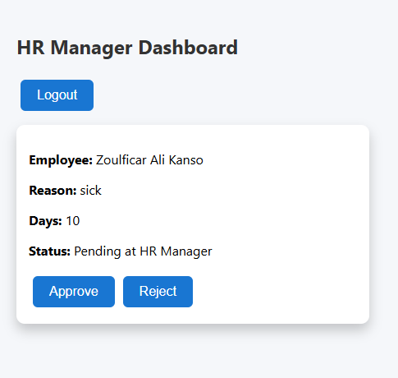
HR MANAGER

Slide 12
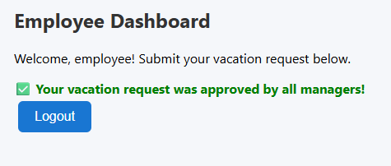
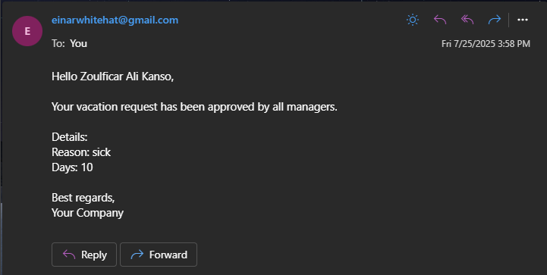
AFTER APPROVAL

Slide 13


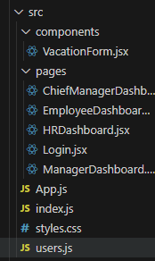
Project File Structure - Root & Global Files
1
Defines the paths (/, /employee, /manager, etc.) and renders the appropriate dashboard component based on the URL. Acts as the application's entry point for navigation.
App.js
2
Renders the root React component (<App />) into the HTML DOM, making the application interactive in the browser.
Index.js
3
Contains custom CSS rules that define the overall look and feel of your components (e.g., button styles, card layouts).
Styles.css
4
Acts as a simple, local user database for the authentication process in the frontend.
Users.js

Slide 14
Project File Structure - Pages & Components
1
Validates user credentials against users.js and redirects users to their role-specific dashboards.
Login.jsx
2
Employee Dashboard.jsx
Fetches requests awaiting manager approval and provides "Approve/Reject" options.
3
Each dashboard fetches requests specifically awaiting approval at its respective stage and enables the manager to "Approve" or "Reject" them, moving the request to the next stage or ending the workflow.
Managers
Dashboard.jsx
4
Facilitates structured input for the reason and duration of leave, then handles the initial submission of this data to the backend..
VacationForm.jsx

Slide 15
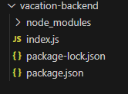
Project File Structure - Backend
1
Defines API endpoints (/submit, /requests, /approve), implements the multi-level approval logic, manages in-memory vacation requests, and integrates Nodemailer for email notifications. This is where the server-side business logic resides.
Index.js
2
Specifies project name, version, main script, and crucial dependencies like express and cors, enabling package management (e.g., npm install).
Package.json
3
Ensures consistent installations across different environments by locking down the dependency tree, preventing unexpected behavior due to package updates.
Package-lock.json

Slide 16

Project Outcomes & Impact
S
I
Streamlines HR processes
Improves Transparency
E
U
Enhances Communication
User Role Permissions

Slide 17



Development Challenges & Learnings
Challenge 1
Challenge 2
Learning
Data Persistence
Email Configuration
To create your own, choose
a topic that interests you.
Initial challenge with in-memory data (solved by centralizing on backend for this scope).
Setting up Nodemailer (solved by careful troubleshooting of credentials/security).
Importance of clear API design, state management in React, and robust error handling.

Slide 18

Project Summary & Achievements
1
Successfully implemented a multi-level vacation approval system using React and Node.js.
2
Achieved objective of automating and improving HR workflows.
3
Demonstrated practical application of modern web development.
4
Built a foundation for future enhancements.

Slide 19

THANK YOU
Questions & Discussion

